Slide 1
Hurricane Sandy Threat Timeline
Bryan Norcross
Sr. Executive Director of Weather Content
Sr. Hurricane Specialist
The Weather Channel
Interdepartmental Hurricane Conference
College Park, MD
March 5, 2013

Slide 2
Characterizing the Threat
Threat is POSSIBLE
Threat is an INCREASING POSSIBILITY
Threat is LIKELY IF NO CHANGES
Threat is LIKELY
Threat is IMMINENT
Each level of THREAT has a MESSAGE.

Slide 3
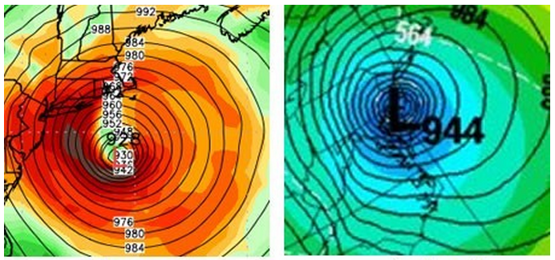
Sunday – October 21
European & Canadian models show a storm near
the Northeast early the following week
Threat: POSSIBLE strong storm early week
Message: Cautionary, if any

Slide 4
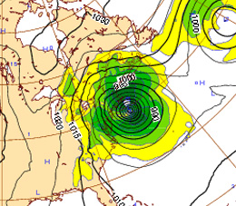
Monday – Wednesday
European Center computer model
and other forecasts continue to show a significant storm near the Northeast
early the following week
Threat: POSSIBLE dangerous storm Monday
Message: Cautionary, if any

Slide 5
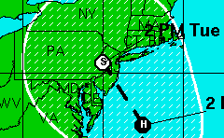
11 AM Thursday
National Hurricane Center forecasts
storm track into New Jersey
WORST CASE track for storm surge
in the NYC region
Threat: INCREASING POSSIBILITY of storm
Message: Forecast shows a storm worse than Irene Monday. Evacuations possible.

Slide 6
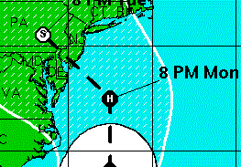
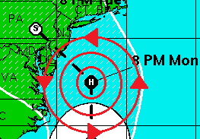
5 PM Thursday
National Hurricane Center forecasts
storm track into New Jersey
WORST CASE track for storm surge
in the NYC region

Slide 7
5 PM Thursday
National Hurricane Center forecasts
storm track into New Jersey
WORST CASE track for storm surge
in the NYC region. Water on
right side of storm pushed into New York bight.
Threat: INCREASING POSSIBILITY of storm
Message: Forecast continues for storm worse than Irene. Evacuations more likely.

Slide 8
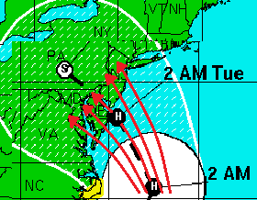
Friday
National Hurricane Center:
USERS ARE REMINDED TO NOT FOCUS ON THE DETAILS OF THE TRACK FORECAST...AS SANDY IS EXPECTED TO BRING IMPACTS TO A LARGE PART OF THE U.S. EAST COAST INTO EARLY NEXT WEEK.
Threat: LIKELY IMPACT if no forecast change
Message: Forecast continues for storm surge worse than Irene. Evacuation orders likely Saturday. Begin preparation of property.

Slide 9
Saturday
National Hurricane Center 11 AM Forecast:
Storm Surge 4 – 8 FEET above ground
Irene surge: 4.36 FEET
Threat: Inundation of coastal sections LIKELY
Message: Storm surge worse than Irene LIKELY. Perhaps much worse. Evacuation ordered for Sunday morning.

Slide 10
Key Questions
What is the WORST PLAUSIBLE THREAT based on what we know now?
When will we know more?
What is the EVACUATION COMMUNICATIONS TIMELINE to allow for mental and physical preparations by residents and visitors?

